Slide 1
Welcome to KnowledgeHut AI hackathon
Ecommerce Product Categorization.
In the rapidly evolving world of eCommerce, accurate product categorization is crucial for ensuring seamless customer experiences, reducing search friction, and increasing product discoverability. However, the sheer volume of diverse products poses a significant challenge. Current classification systems struggle to handle ambiguities, unconventional naming conventions, and multi-language data. This hackathon aims to address these challenges by inviting participants to create innovative solutions that enhance product categorization efficiency, accuracy, and scalability.
Objective: Develop a text classification model that categorizes products with maximum accuracy based on the product description.

Slide 2
Objectives 1-3 This hackathon focuses on creating accurate and efficient solutions for eCommerce product categorization. The key objectives are:
1. Data Exploration and Preparation
Explore and analyze the dataset to understand key features, detect missing data, and identify ambiguities.
Preprocess the dataset for consistency, noise reduction, and missing value handling.
2. Descriptive Analysis
Perform descriptive analysis to identify data patterns, category distributions, and inconsistencies, especially for text data.
Visualize data insights using word clouds and other text visualization techniques.
3. Feature Engineering/Text to Features
Transform raw product data into informative features suitable for machine learning models.
Convert text descriptions into numerical features using techniques such as TF-IDF, word embedding's, or custom methods.

Slide 3
Objectives 4-6 This hackathon focuses on creating accurate and efficient solutions for eCommerce product categorization. The key objectives are:
4. Predictive Modeling
Design and develop machine learning models using text data for accurate product categorization.
Consider classification, clustering, or hybrid models based on problem requirements.
Ensure the model can handle ambiguous products.
5. Fine Tuning
Optimize models by tuning hyperparameters and selecting relevant features.
Evaluate and compare models using metrics such as accuracy, F1 score, precision, and recall.
Validate models through cross-validation or a separate test dataset.
6. Enhance Categorization Accuracy
Improve model accuracy by incorporating domain-specific knowledge or ensemble methods.
Ensure solutions can accurately categorize unconventional product names and handle ambiguities.
Develop models that support scalable, real-time categorization.

Slide 4
Expected Outcomes By the end of the hackathon, participants are expected to deliver the following outcomes:
1. Predictive Model
A text-based predictive machine learning model capable of accurate product categorization across multiple categories.
The model will be evaluated using accuracy, F1 score, precision, and recall, ensuring high classification performance.
2. Visualizations
A comprehensive set of visualizations will accompany the model, providing insights into data patterns, category distributions, word clouds, etc.

Slide 5
importing the libraries
import numpy as np
import pandas as pd
import seaborn as sns
import matplotlib.pyplot as plt
import warnings
warnings.filterwarnings('ignore')

Slide 6
1. Analyze the Dataset:
1. Connect and read the dataset to jupyter notebook
df=pd.read_csv('C:/Rohan Data/train_product_data.csv')
2. Check the data set
df.head()
3. Check the data size
df.shape
4. Check the info about the dataset
df.info()
5. Describe the dataset
df.describe()
6. defining features for analysis
x=['product_category_tree','description']
df1=df[x]
df1.head()

Slide 7
EDA handling the missing values
product_category_tree 0 description 1 dtype: int64
product_category_tree 0 description 1 dtype: int64
(14998, 2)
1. df1.isnull().sum()
product_category_tree 0
description 1
dtype: int64
2. df1.dropna(inplace=True)
df1.shape
(14998, 2)
3. df1.describe()
product_category_tree | description
count | 14998 | 14998
unique | 14 | 13163
top | Clothing | Fashion Jewellery Alloy Necklace - Buy Fashion...
freq | 5315 | 38

Slide 8
2. Visualize the Data:
#Identify Non-Numeric Values
import pandas as pd
# Example DataFrame
data = {'product_category_tree': ['123.45', '678.90', 'Clothing ']}
df = pd.DataFrame(data)
# Check for non-numeric values
df['product_category_tree'] = pd.to_numeric(df['product_category_tree'], errors='coerce')
print(df)
product_category_tree
0 123.45
1 678.90
2 NaN

Slide 9
Clean Your Data – step 1
#Remove Non-Numeric Values
# Example DataFrame
data = {'product_category_tree': ['123.45', '678.90', 'Clothing ']}
df = pd.DataFrame(data)
# Remove rows with non-numeric values
df['product_category_tree'] = pd.to_numeric(df['product_category_tree'], errors='coerce')
df = df.dropna() # Drop rows with NaN values

Slide 10
Clean Your Data – step 2
#Replace Non-Numeric Values:
# Example DataFrame
data = {'product_category_tree': ['123.45', '678.90', 'Clothing ']}
df = pd.DataFrame(data)
# Replace non-numeric values with a specific number (e.g., 0)
df['product_category_tree'] = pd.to_numeric(df['product_category_tree'], errors='coerce').fillna(0)

Slide 11
1. Ensure Proper Data Types 2. Check for Extra Spaces
1. Ensure Proper Data Types
df = pd.read_csv('C:/Rohan Data/train_product_data.csv')
df['product_category_tree'] = pd.to_numeric(df['product_category_tree'], errors='coerce')
Check for Extra Spaces
# Example DataFrame with extra spaces
data = {'roduct_category_tree': ['123.45 ', ' 678.90', ' Clothing']}
df = pd.DataFrame(data)
# Strip extra spaces
df['roduct_category_tree'] = df['roduct_category_tree'].str.strip()
# Convert to numeric
df['roduct_category_tree'] = pd.to_numeric(df['roduct_category_tree'], errors='coerce')

Slide 12
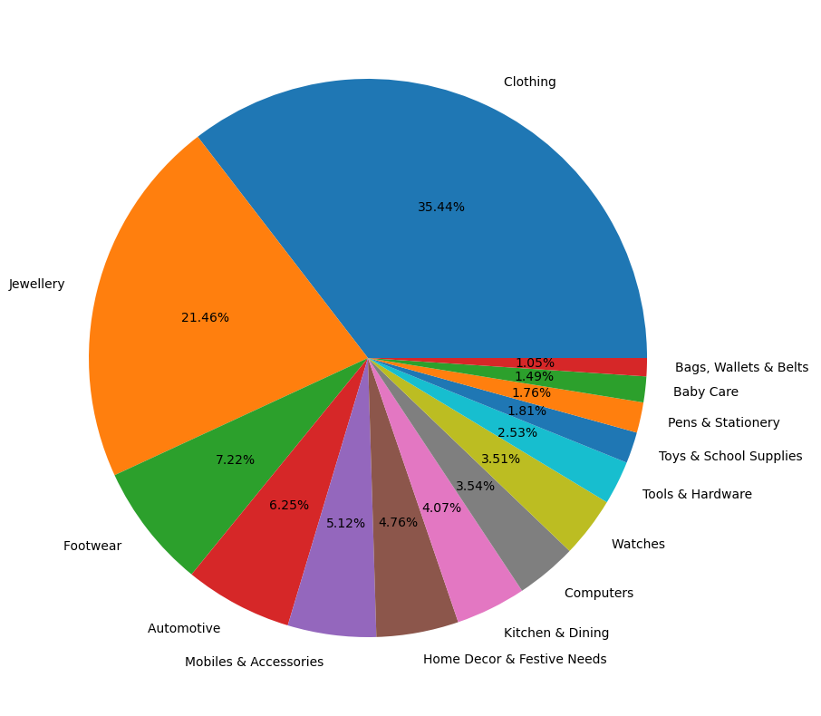
visualization using pie chart
plt.figure(figsize=(10,10))
plt.pie(df1['product_category_tree'].value_counts(),labels=df1['product_category_tree'].value_counts().index,autopct='%1.2f%%')
plt.show()

Slide 13
Find out unique value
array(['Clothing ', 'Footwear ', 'Pens & Stationery ', 'Bags, Wallets & Belts ', 'Home Decor & Festive Needs ', 'Automotive ', 'Tools & Hardware ', 'Baby Care ', 'Mobiles & Accessories ', 'Watches ', 'Toys & School Supplies ', 'Jewellery ', 'Kitchen & Dining ', 'Computers '], dtype=object)
cat_t=df1['product_category_tree'].unique()
cat_t
array(['Clothing ', 'Footwear ', 'Pens & Stationery ',
'Bags, Wallets & Belts ', 'Home Decor & Festive Needs ',
'Automotive ', 'Tools & Hardware ', 'Baby Care ',
'Mobiles & Accessories ', 'Watches ', 'Toys & School Supplies ',
'Jewellery ', 'Kitchen & Dining ', 'Computers '], dtype=object)

Slide 14
Create word cloud
import matplotlib.pyplot as plt
from wordcloud import WordCloud
# Assuming 'cat_t' is a list of unique product categories
cat_t = df1['product_category_tree'].unique()
for i in cat_t:
# Word cloud for book descriptions in each category
all_text = ' '.join(df1[df1['product_category_tree'] == i]['description'])
wordcloud = WordCloud(width=800, height=400, background_color='white').generate(all_text)
plt.figure(figsize=(10, 6))
plt.imshow(wordcloud, interpolation='bilinear')
plt.title(f'Word Cloud of Descriptions of Books in Category: {i}')
plt.axis('off')
plt.show()

Slide 15
Data preprocessing cleaning the data here by using the spacy library which is use here for text data cleaning
pip install spacy
import re
import spacy
# Load spaCy's English language model
nlp = spacy.load('en_core_web_sm')
def clean_text(text):
"""
Clean and preprocess text using spaCy and regular expressions.
Parameters:
text (str): The input text to be cleaned.
Returns:
str: The cleaned and preprocessed text.
"""
# Converting to lowercase
text = text.lower()
# Removing special characters
text = re.sub(r'[^a-z\s]', '', text)
# Handling empty strings
if not text.strip():
return ''
# Using spaCy to lemmatize, remove stop words, and punctuations
doc = nlp(text)
tokens = []
for token in doc:
if not token.is_stop and not token.is_punct:
tokens.append(token.lemma_)
cleaned_text = ' '.join(tokens)
return cleaned_text

Slide 16
Encoding Encoding the categorical data into the numerical by the help of using the sklearn function label encoder
from operator import le
from sklearn.preprocessing import LabelEncoder
le=LabelEncoder()
df1['product_category_tree']=le.fit_transform(df1['product_category_tree'])
df1['product_category_tree'].value_counts()
Answer in Notebook

Slide 17
4. Feature Engineering/Text to Features: Split the dataset into independent and dependent features convert text to numerical representation using TF-IDF¶
from sklearn.feature_extraction.text import TfidfVectorizer
# Convert text to numerical representation using TF-IDF
vectorizer = TfidfVectorizer()
X = vectorizer.fit_transform(df1['description'])
y = df1['product_category_tree']
X.shape
Answer is (14998, 16307)
(14998, 16307)

Slide 18
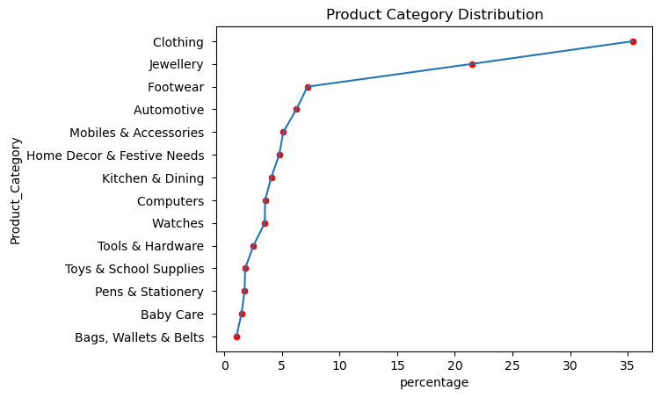
5. Address Class Imbalance:
# plt.figure(figsize=(5,5))
sns.lineplot(SS_df,x='percentage',y='Product_Category',)
sns.scatterplot(SS_df,x='percentage',y='Product_Category',color='red')
plt.title('Product Category Distribution')
plt.show()

Slide 19
Analysis:
High Proportions: Categories like Clothing and Jewellery dominate the dataset with a significant percentage of the instances.
Low Proportions: Categories such as Bags, Wallets & Belts and Baby Care have much lower proportions, indicating they are underrepresented.
Imbalance: The chart clearly shows that some categories are heavily favored over others. This imbalance can impact machine learning models, as models may become biased towards the more frequent categories

Slide 20
Using the smote here to treating the imbalce dataset treating installing imbalanced-using the smote here to treating the imbalce dataset treating
pip install imbalanced-learn -i https://pypi.org/simple
pip install imbalanced-learn -i https://pypi.tuna.tsinghua.edu.cn/simple
pip install --upgrade pip setuptools wheel
pip install --upgrade scikit-learn
pip install scikit-learn==1.2.2
from imblearn.over_sampling import SMOTE
# Apply SMOTE to balance the training set
smote = SMOTE(random_state=42)
X_train_balanced, y_train_balanced = smote.fit_resample(X_train, y_train)

Slide 21
6. Develop Machine Learning- Multi-class text classifier:
from sklearn.linear_model import LogisticRegression
from sklearn.metrics import classification_report
# Train model
model = LogisticRegression(max_iter=1000)
model.fit(X_train_balanced, y_train_balanced)
# Predict and evaluate
y_pred = model.predict(X_test)
print(classification_report(y_test, y_pred))

Slide 22
precision recall f1-score support
0 0.98 0.98 0.98 198
1 0.85 0.86 0.85 51
2 0.91 0.97 0.94 31
3 0.99 0.99 0.99 1083
4 0.94 0.95 0.95 107
5 1.00 0.98 0.99 220
6 0.98 0.99 0.98 154
7 1.00 1.00 1.00 608
8 0.95 0.98 0.97 114
9 0.97 0.97 0.97 171
10 0.84 0.88 0.86 41
11 1.00 0.99 0.99 79
12 0.86 0.79 0.83 48
13 1.00 1.00 1.00 95
accuracy 0.98 3000
macro avg 0.95 0.95 0.95 3000
weighted avg 0.98 0.98 0.98 3000

Slide 23
from sklearn.model_selection import GridSearchCV
# Define parameter grid
param_grid = {
'C': [0.1, 1, 10],
'solver': ['liblinear', 'lbfgs']
}
# Initialize GridSearchCV
grid_search = GridSearchCV(LogisticRegression(max_iter=1000), param_grid, cv=5, n_jobs=-1)
grid_search.fit(X_train, y_train)
# Best parameters and model
print("Best Parameters:", grid_search.best_params_)
best_model = grid_search.best_estimator_
Answer - : Best Parameters: {'C': 10, 'solver': 'lbfgs'}

Slide 24
best_model = LogisticRegression(max_iter=1000, C=10, solver='lbfgs')
best_model.fit(X_train, y_train)
Answer - :-
LogisticRegression
LogisticRegression(C=10, max_iter=1000)

Slide 25
Classification report
Code
Answer :-
from sklearn.metrics import confusion_matrix, classification_report
# Predict and evaluate
y_pred = best_model.predict(X_test)
# Classification report
print(classification_report(y_test, y_pred))
precision recall f1-score support
0 0.98 0.99 0.99 198
1 0.93 0.80 0.86 51
2 0.94 0.97 0.95 31
3 0.99 1.00 0.99 1083
4 0.95 0.96 0.96 107
5 1.00 0.99 0.99 220
6 0.97 0.99 0.98 154
7 1.00 1.00 1.00 608
8 0.96 0.98 0.97 114
9 0.98 0.95 0.96 171
10 0.81 0.85 0.83 41
11 1.00 0.99 0.99 79
12 0.86 0.75 0.80 48
13 1.00 1.00 1.00 95
accuracy 0.98 3000
macro avg 0.96 0.94 0.95 3000
weighted avg 0.98 0.98 0.98 3000

Slide 26
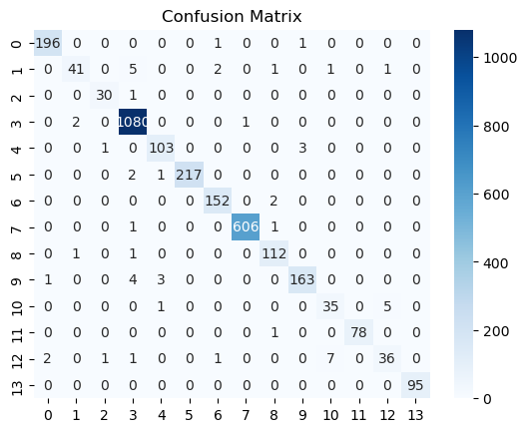
Confusion matrix
cm = confusion_matrix(y_test, y_pred)
sns.heatmap(cm, annot=True, fmt='d', cmap='Blues')
plt.title('Confusion Matrix')
Answer :- Text(0.5, 1.0, 'Confusion Matrix')
op=open('model_logi_nlp.pkl','wb')
pickle.dump(best_model,op)
op.close()

Slide 27
Decision tree
precision recall f1-score support
0 0.98 0.98 0.98 198
1 0.85 0.86 0.85 51
2 0.91 0.97 0.94 31
3 0.99 0.99 0.99 1083
4 0.94 0.95 0.95 107
5 1.00 0.98 0.99 220
6 0.98 0.99 0.98 154
7 1.00 1.00 1.00 608
8 0.95 0.98 0.97 114
9 0.97 0.97 0.97 171
10 0.84 0.88 0.86 41
11 1.00 0.99 0.99 79
12 0.86 0.79 0.83 48
13 1.00 1.00 1.00 95
accuracy 0.98 3000
macro avg 0.95 0.95 0.95 3000
weighted avg 0.98 0.98 0.98 3000
# Pridict and evaluate
y_pred = model.predict(X_test)
# Classification report
print(classification_report(y_test, y_pred))

Slide 28
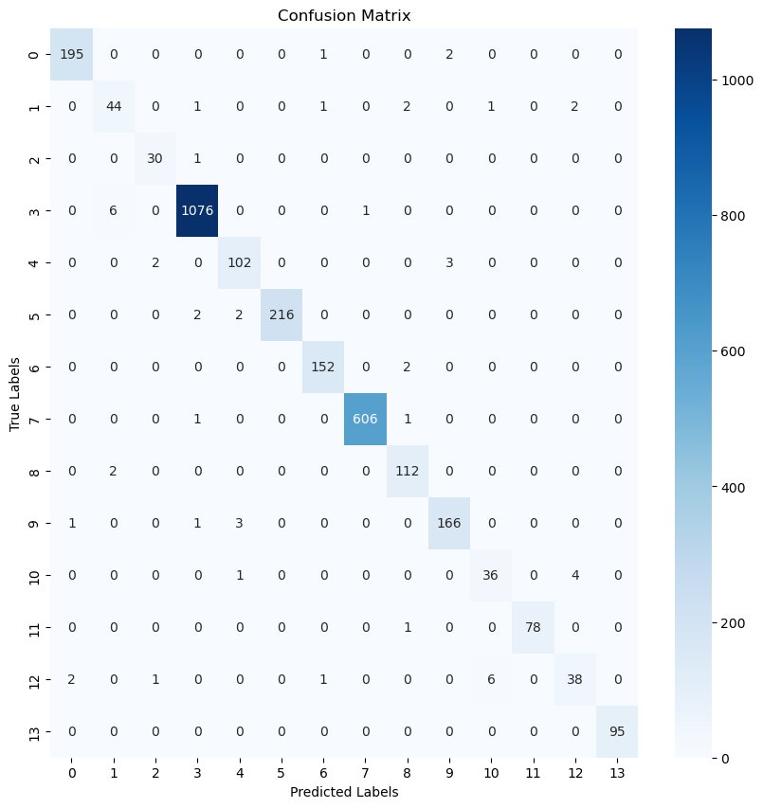
plt.figure(figsize=(10,10))
cm = confusion_matrix(y_test, y_pred)
sns.heatmap(cm, annot=True, fmt='d', cmap='Blues')
plt.title('Confusion Matrix')
plt.xlabel('Predicted Labels')
plt.ylabel('True Labels')
plt.show()

Slide 29
Random forest model¶
precision recall f1-score support
0 0.98 0.98 0.98 198
1 0.85 0.86 0.85 51
2 0.91 0.97 0.94 31
3 0.99 0.99 0.99 1083
4 0.94 0.95 0.95 107
5 1.00 0.98 0.99 220
6 0.98 0.99 0.98 154
7 1.00 1.00 1.00 608
8 0.95 0.98 0.97 114
9 0.97 0.97 0.97 171
10 0.84 0.88 0.86 41
11 1.00 0.99 0.99 79
12 0.86 0.79 0.83 48
13 1.00 1.00 1.00 95
accuracy 0.98 3000
macro avg 0.95 0.95 0.95 3000
weighted avg 0.98 0.98 0.98 3000
Accuracy: 0.982
from sklearn.metrics import classification_report, accuracy_score
# Predict on the test set
y_pred = model.predict(X_test)
# Print the classification report
print(classification_report(y_test, y_pred))
# Print the accuracy score
print("Accuracy:", accuracy_score(y_test, y_pred))

Slide 30
from sklearn import metrics
# Calculate the F1 score with weighted average
f1_score = metrics.f1_score(y_test, y_pred, average='weighted')
# Print the F1 score
print("Random forest F1 score:", f1_score)
plt.figure(figsize=(10,10))
cm = confusion_matrix(y_test, y_pred)
sns.heatmap(cm, annot=True, fmt='d', cmap='Blues')
plt.title('Confusion Matrix')
plt.xlabel('Predicted Labels')
plt.ylabel('True Labels')
plt.show()
Random forest F1 score: 0.9820024046342529

Slide 31
Model Building
Deep learning model
Import Libraries for deep learning model
Import all the necessary libraries and modules needed for data manipulation, model building, and evaluation
Sequential, Dense, Dropout, Embedding, LSTM, Bidirectional from TensorFlow/ Keras for building the neural network.
Tokenizer and pad_sequences for text preprocessing
Tokenization and Padding:
Convert text to sequences of integers.
Pad sequences to ensure uniform input size
Data cleaning

Slide 32
Distribution of the category into the dataset Label Encoding: Convert categorical target labels to integers.
# df1 is DataFrame and 'product_category_tree' is the column we're encoding
label_encoder = LabelEncoder()
# Fit the LabelEncoder on the specified column
y = label_encoder.fit_transform(df1['product_category_tree'])
# Save the fitted LabelEncoder to a file using pickle
with open('label_encoder2.pkl', 'wb') as f:
pickle.dump(label_encoder, f)
X_train, X_test, y_train, y_test = train_test_split(X, y, test_size=0.2, random_state=42)
# Apply SMOTE to balance the training set
smote = SMOTE(random_state=42)
X_train_balanced, y_train_balanced = smote.fit_resample(X_train, y_train)

Slide 33
Sequential(): This initializes a linear stack of layers. You can add layers to the model one by one. The output of one layer will be the input to the next layer.
model_deep=Sequential()
model_deep.add(Embedding(input_dim=10000,output_dim=128,input_length=100))
model_deep.add(Bidirectional(LSTM(64)))
model_deep.add(Dropout(0.5))
model_deep.add(Dense(64,activation='relu'))
model_deep.add(Dropout(0.5))
model_deep.add(Dense(len(label_encoder.classes_),activation='softmax'))

Slide 34
Embedding Layer
Embedding(): This layer is used for turning positive integers (indexes) into dense vectors of fixed size. It's often used as the first layer in a model dealing with text data.
Parameters
input_dim=10000: The size of the vocabulary. In this case, it means we have 10,000 unique words in our vocabulary.
output_dim=128: The size of the dense embedding vectors. Each word will be represented as a 128-dimensional vector.
input_length=100: The length of input sequences. Each input sequence will be padded/truncated to this length.
Bidirectional Wrapper
Bidirectional(): This wrapper allows an RNN (like LSTM or GRU) to learn information from both the past and future by processing the input sequence in both forward and backward directions.
Parameters
LSTM(64): An LSTM (Long Short-Term Memory) layer with 64 units. LSTMs are a type of recurrent neural network (RNN) that can learn long-term dependencies. Using LSTM inside Bidirectional means we have one LSTM layer processing the sequence forward and another processing it backward, and their outputs are concatenated.
Dropout Layer
Dropout(0.5): Dropout is a regularization technique used to prevent overfitting. It randomly sets a fraction of the input units to 0 at each update during training time, which helps in making the model robust. The fraction (0.5) means that 50% of the input units are set to 0.
Dense Layer
Dense(64): A fully connected (dense) layer with 64 units. Each unit receives input from all units of the previous layer.
activation='relu': The ReLU (Rectified Linear Unit) activation function. It introduces non-linearity to the model, allowing it to learn more complex patterns. ReLU outputs 0 if the input is negative, and outputs the input itself if the input is positive.
Dropout(0.5): Another dropout layer with a dropout rate of 50%. This helps further in reducing overfitting.
Output Layer
Dense(len(label_encoder.classes_)): A dense layer with a number of units equal to the number of unique classes in your target variable (as given by label_encoder.classes_). This layer represents the output of the model.
activation='softmax': The softmax activation function. It is used in the output layer of a classification model to output a probability distribution over the classes. Each unit will output a probability value, and all these values will sum to 1, which allows the model to predict the class probabilities for the given input.

Slide 35
Excel Using the test dataset
Code visualize in Jupyter Notebook

Slide 36
THE end

Slide 37
Video walkthrough
THE END Thank you.

